Slide 1
UPS Lecture
1. Have the students read a suitable reference (e.g. the Wikipedia entry) on UPS: https://en.wikipedia.org/wiki/Ultraviolet_photoelectron_spectroscopy. Ask the students to commit the photoelectric equation to memory as we will explore extensions of it.
2. Highlight and discuss the differences between XPS and UPS focusing on applications to solid materials.
3. Explore aspects of UPS measurements, theory and analysis.
4. Bring real data (e.g. gold & C60) for the class to analyze and interpret.
5. At the end of the class, students should be able to, given a spectra, calculate the work function and ionization potential of the sample, explain the physics behind onset and cutoff regions of the spectra and build a band diagram.

Slide 2
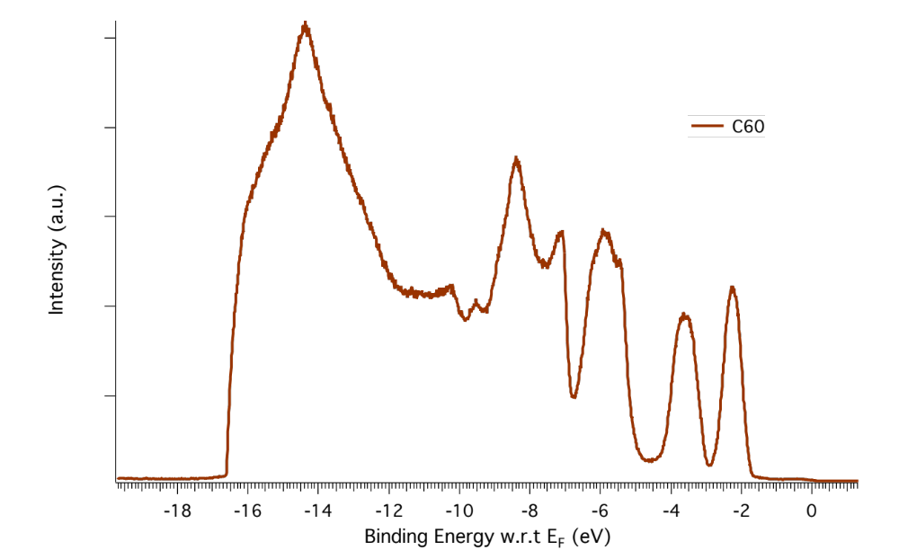

Slide 3
